Slide 1

OPENING NEW RESTAURANT
Made by: Dhirender Singh Rawat

Slide 2
ANALYSIS – OPENING NEW RESTAURANT
Analyzing Countries with less competition.
States and Cities for opening new restaurant.
Rating – in the suggested country.
Total expenditure on food – in the suggested country.
Online delivery / table booking.
Competitors.
Cuisines.
Restaurants in different price range.
Dashboard.

Slide 3
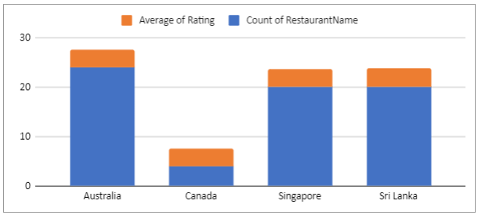
Country with less competition
The selection of countries has been done on the basis of two factor:
Less Competition
The ratings are average in the countries
– the rating has been taken into consideration
as this indicates the people are not satisfied
with the type of restaurant that are there.
(Australia,Canada,Singapore,Sri Lanka)

Slide 4
Country selected Cities
Australia = (Armidale, Flaxton, Macedo)
Canada = (Yorkton, Chatham-kent, consort, Vineland station)
Singapore = (Singapore)
Sri Lanka = ( Colombo)

Slide 5
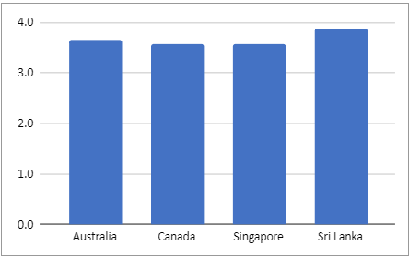
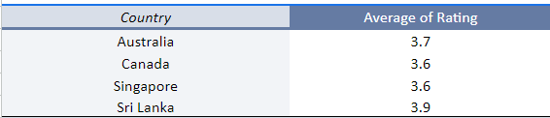
Average Rating of Restaurants in Selected Countries
The ratings in the selected countries are in the range 3.6 to 4.0. The average of ratings are giving insights that people are not fully satisfied with some restaurants.
And hence its an opportunity for us to attract the people by providing the best of food and services.

Slide 6
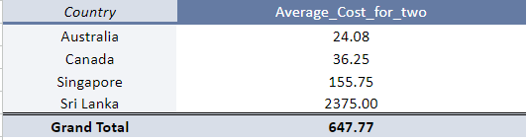
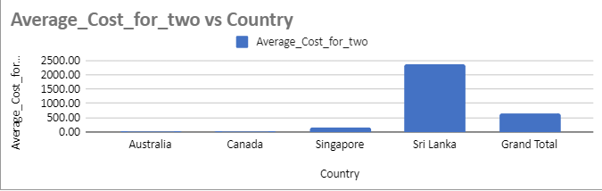
Expenditure on Food

Slide 7
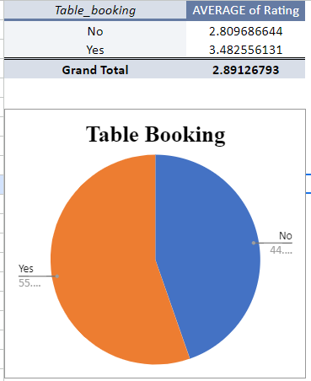
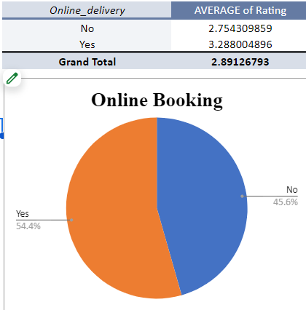
Delivery Analysis of Food

Slide 8
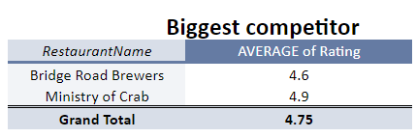
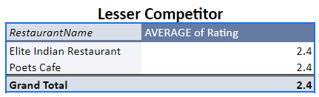
Biggest & lesser Competitor

Slide 9
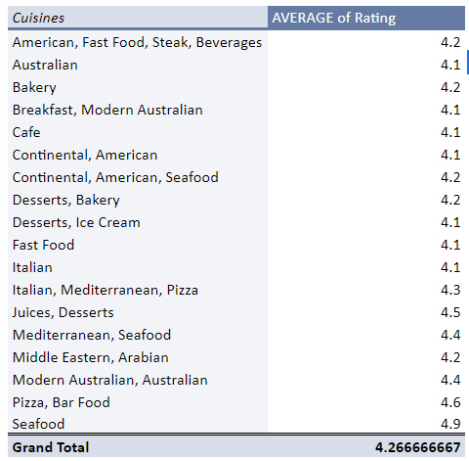
Diverse Culinary Delights:Explorings Cuisines

Slide 10
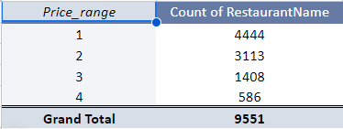
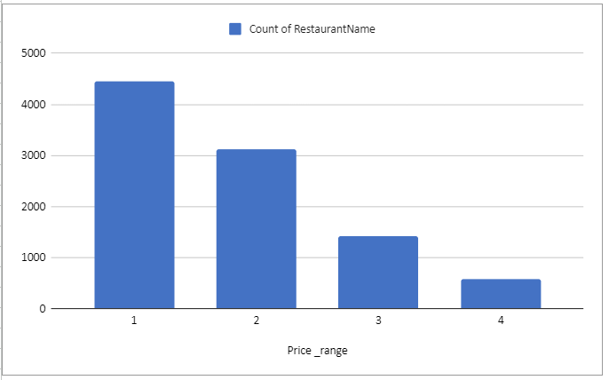
Restaurant in different price range

Slide 11
Thank You
Have a great day !

